Slide 1
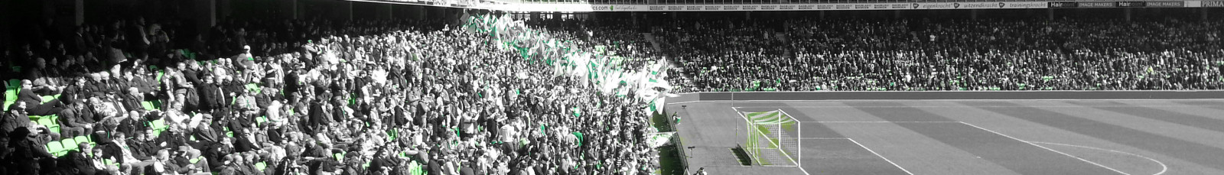

STICHTING
FC GRONINGEN SUPPORTERS
Volksclub! Volk in de club

Slide 2
Waarom dit initiatief?
Wat is ons doel: Club bewaken voor de toekomst
Professionele supporters organisatie neerzetten
Ondanks de verschillen slaan de supporters de handen in één
Ook de individuele supporters een stem geven
Zichtbaar, actief en betrokken
Veel kennis, ervaring en contacten die nodig zijn, zit bij de supporters
Gevolg: Duurzame goede relatie tussen club en supporters

Slide 3
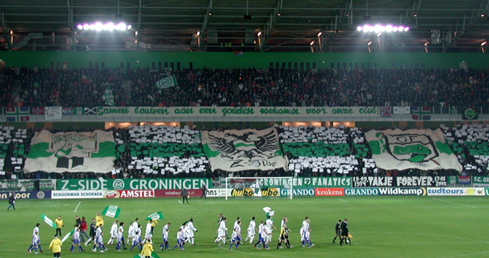
SUPPORTERS SAMEN ÉÉN
Supporters samen één!!!

Slide 4
Waarom dit initiatief?
WAAROM NU?
Overleg tussen club en supporters is goed, maar binding laag
Vele voorbeelden hoe het niet moet
Meeliften met lopende initiatieven
Pioniers binnen Nederland

Slide 5
Hoe werkt het in de rest van Europa?

Slide 6

Groningen, 3 October 2013
Supporters Direct Europe:
Fans at the Heart of the Game
Ben Shave
Development Officer, Supporters Direct Europe
ben.shave@supporters-direct.coop
www.supporters-direct.coop
@SuppDirect

Slide 7

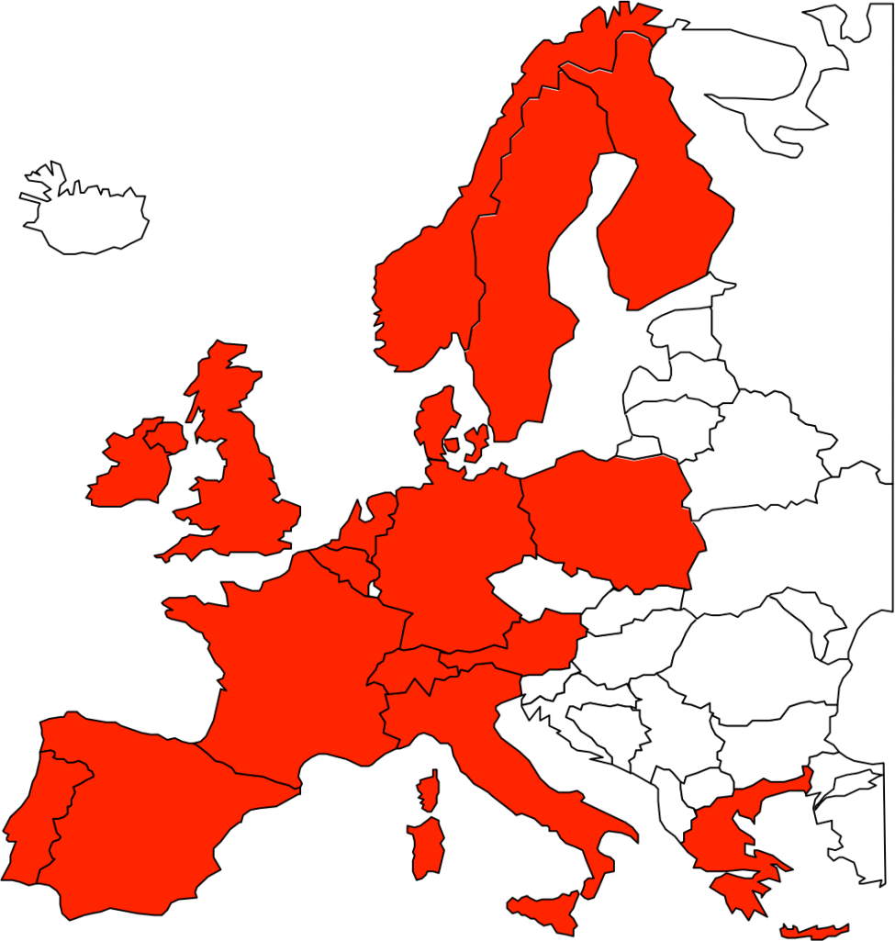
Who we are
Founded in the UK in 2000 – we’ve helped set up 180 supporters’ trusts since
From 2007, we have also worked alongside fans in many European countries
Groups at clubs, national organisations, associations and governing bodies
All are democratic, non-violent, non-discriminatory, inclusive, not-for-profit

Slide 8
What We Do
Assist supporters in over 20 countries in setting up democratic cooperatives: Supporters’ Trusts;
Help supporters become involved in the ownership and decision making process at their clubs;
Advise clubs, governing bodies and other institutions about alternative/inclusive ownership and governance models.
Help facilitate implementation of Supporter Liaison Officers (Art. 35, UEFA Club Licensing and Financial Fair Play Regulations).

Slide 9
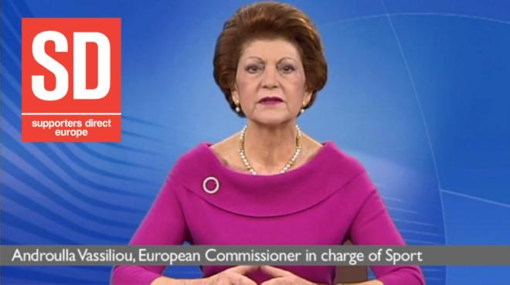
Official Support
“The work of Supporters Direct Europe shows how fans can help to develop inclusive and sustainable structures at both their grassroots and professional levels, giving life to the concept of active citizenship and demonstrating how supporters can contribute to better governance and long term sustainability in sport”

Slide 10
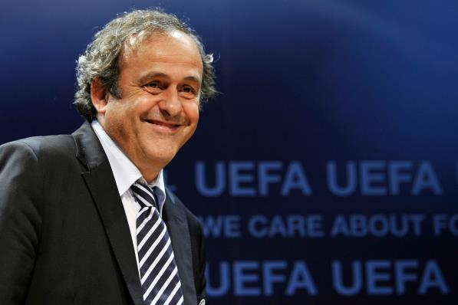
Official Support
“I have always said that fans are a fundamental part of the identity of football clubs and we are pleased continue supporting the work of Supporters Direct Europe in bringing good governance to clubs across Europe by encouraging initiatives to involve fans in the ownership and running of their clubs. It is also particularly pleasing that after our initial support for Supporters Direct Europe, the European institutions have picked up on it as well”

Slide 11
We Promote
Social and community value of sports clubs;
Improved relationships between governing bodies, clubs and supporters;
Good governance and greater transparency in sport;
Democratic representation for supporters at football clubs and governing bodies.

Slide 12
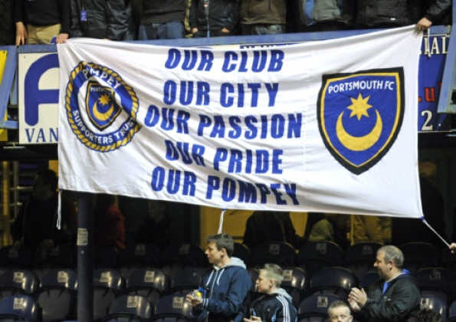
Case Study: Portsmouth FC

Slide 13
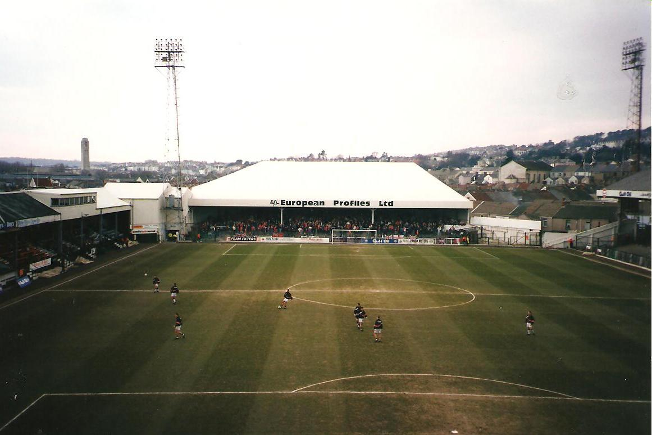
Case Study: Swansea City

Slide 14
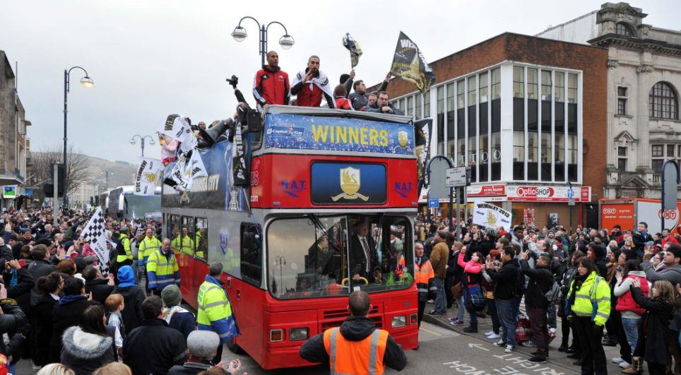
Swansea City

Slide 15
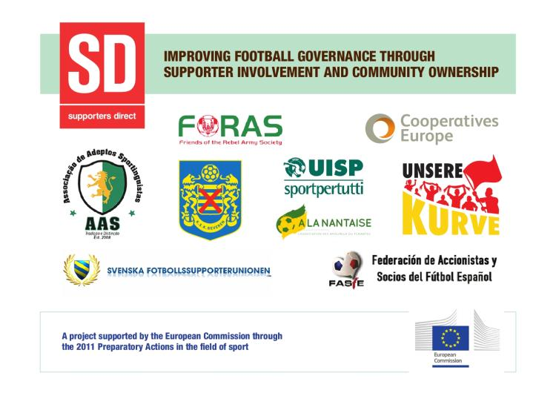


Slide 16
Objectives
Strengthen the European supporter ownership network;
Promote good governance amongst supporters’ trusts/groups, clubs, and other stakeholders;
Promote democratic ownership structures in football;
Promote football's social value through supporter involvement;
Develop a long-term vision for spreading good governance principles from clubs to governing bodies and other sports.
Develop/improve relationships between supporters’ groups and governing bodies.

Slide 17
Outputs
Needs analysis and national surveys
To inform the project of needs of supporters‟ trusts/groups in relation to the
governance of their clubs and national associations
Establishment of national supporters’ organisations
New: Italy and Ireland;
Enabling and empowering: Sweden, Spain, Germany, France;
Workshops in seven countries
Ireland, Spain, Portugal, Italy, Sweden, Belgium and France
ALL stakeholders involved
Eight handbooks
About how to improve the governance of football in partners’ countries
Guidance and recommendations for supporters, institutions and governing bodies.

Slide 18
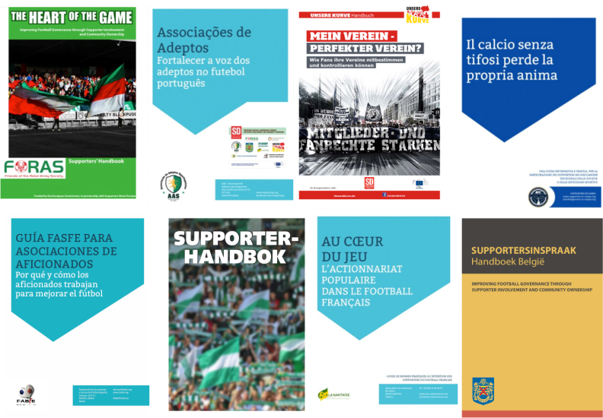
Partner handbooks

Slide 19

Supporters in Campo
National network for democratic Italian supporters’ groups
Launched with 11 founding members in June 2013
Promotes: supporter participation in decision making and governance structures; better relationships between all stakeholders
www.supporters-in-campo.org

Slide 20
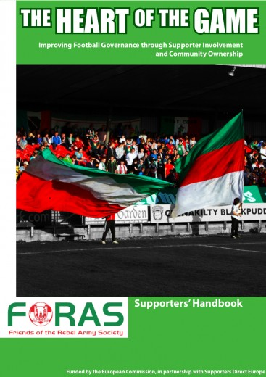
Heart of the Game network, ROI
Network for Irish supporters’ trusts and supporter owned clubs, to ideas and work on collective issues
Aimed at building greater co-operation between fans who have a common interest in protecting and improving Irish football
Developed following launch of the toolkit by Minister for Sport Michael Ring at the Dáil Éireann, June 2013

Slide 21

Swedish 50+1 rule preserved
Campaign to preserve the ‘50+1’ rule coordinated by SD Europe partner Svenska Fotbollssupporterunionen
Members of eight clubs put forward motions at their AGMs requiring clubs to lobby in favour of the rule being retained
May 2013 vote at the country’s Sports Confederation decisively in favour of preserving the rule

Slide 22

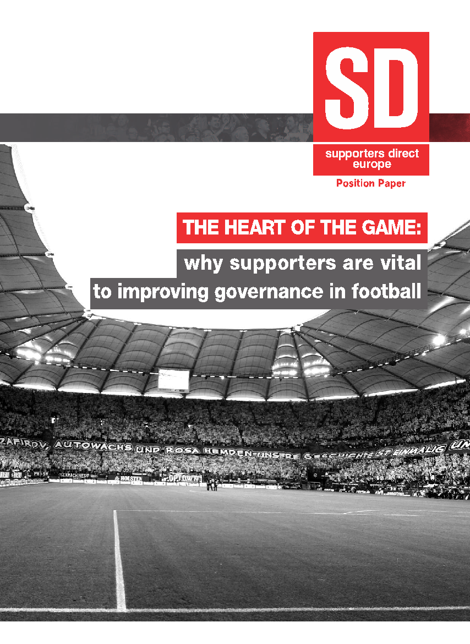






Benefits of Fan Involvement

Slide 23
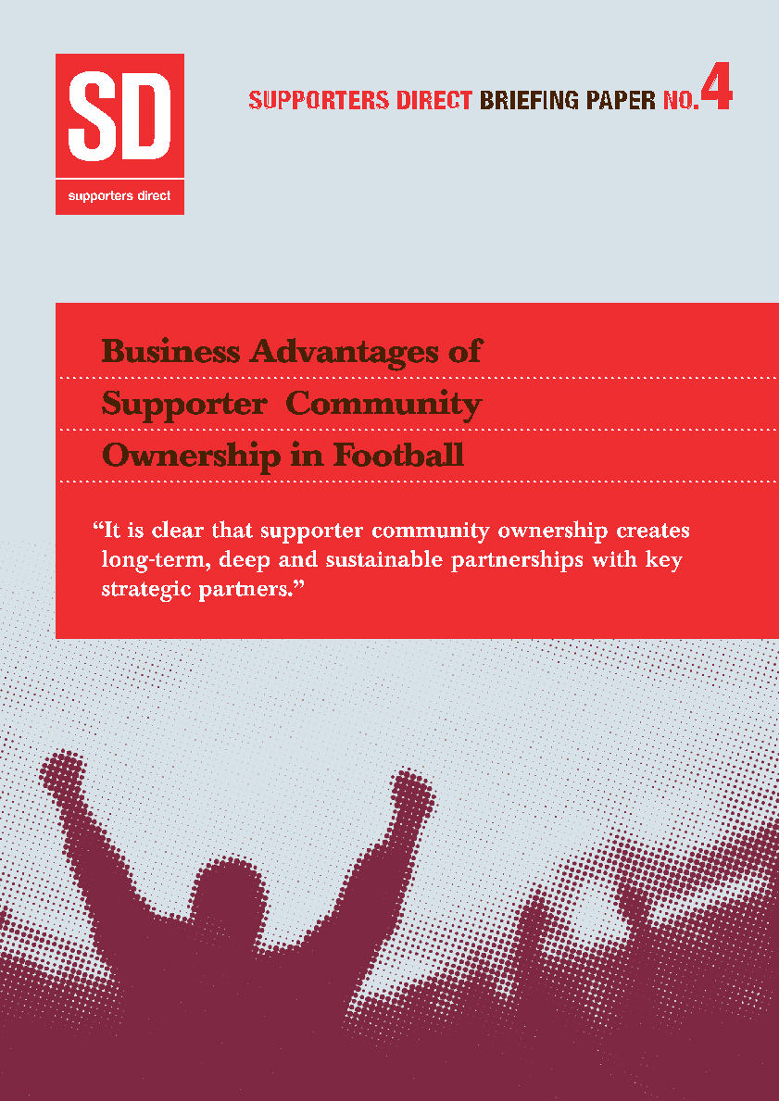
Benefits of Fan Involvement
Your club, your rules
Strategic partnerships
Transparency, openness, trust
A club at the heart of its community, built to last

Slide 24
Contact
Ben Shave
Development Officer, Supporters Direct Europe
+44 7985 628 215
ben.shave@supporters-direct.coop
www.supporters-direct.coop
@SuppDirect

Slide 25

Pronkjewail van Groningen!
Gouden aandeel: Het pronkjewail van Groningen
Clubnaam
Clublogo
Speelstad
Clubkleuren
Thuis shirt
Club klaar maken en behouden voor de toekomst
Meer betrokkenheid, meer activiteit

Slide 26
De huidige situatie en hoe zien wij het?

Slide 27

Stichting Houdstermaatschappij van Aandelen
FC Groningen
FC Groningen Beheer BV
FC Groningen media BV
Euroborg horeca BV
FC Groningen BV
Preventief BV
Licentie betaald voetbal

Slide 28
Uitgangspunten Stichting
Betrokkenheid
Sociaal-maatschappelijk
Non-profit
Democratisch
Transparant

Slide 29

Structuur stichting
Toezichthouders
Stichting FC Groningen Supporters
Bestuur stichting
Medewerkers

Slide 30
Aandeelhouders, donateurs & sponsoren
Aandeelhouders
Donateurs
Sponsoren

Slide 31
Wat bieden wij sponsoren
De binding en het saamhorigheidsgevoel van minimaal 15.000 supporters
Mogelijkheid om ideeën i.s.m. supporters te ontwikkelen
Sponsoren toegang tot de businessruimte
Netwerk mogelijkheden

Slide 32
Samengevat: wat is nodig?
Een gouden aandeelconstructie (Pronkjewail)
Toegang tot de sponsorruimte na afloop van de wedstrijd voor sponsoren van de stichting

Slide 33
Samengevat: wat levert het op
Garantie voortbestaan FC Groningen
Vastleggen wat FC Groningen kenmerkt
Vergroten en behouden binding supporters en club, via:
Professionele supportersorganisatie
Groningen zichtbaar
Groningen in de maatschappij
Groningen duurzaam
Klaar voor de toekomst

Slide 34
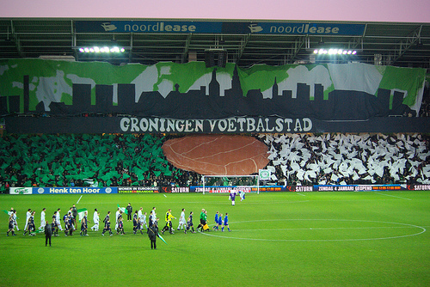

Slide 35

FC Groningen Volksclub
VOLK IN DE CLUB!!!

